Slide 1

3D structure of the nucleon in the momentum space and the Electron-Ion Collider

Slide 2
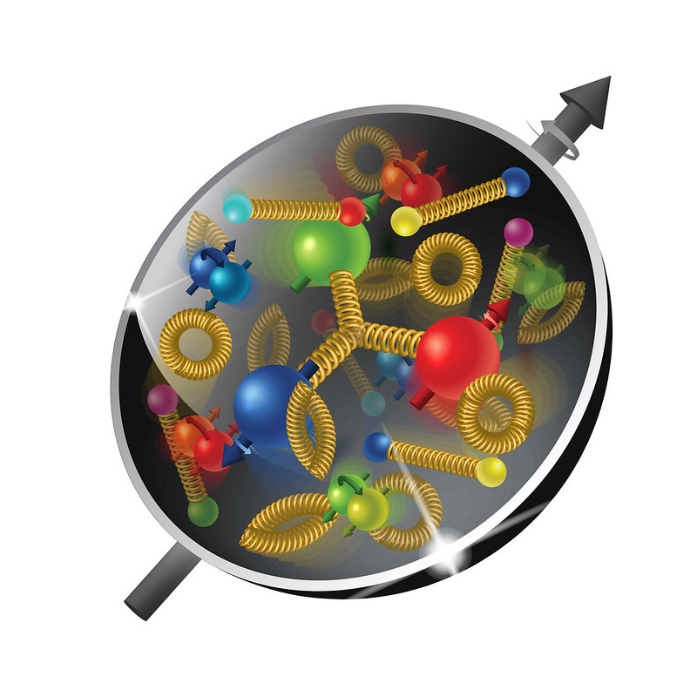
The plan
Lecture I:
Structure of the nucleon
Transverse Momentum Dependent distributions (TMDs)
Semi Inclusive Deep Inelastic Scattering (SIDIS)
Calculations of SIDIS structure functions using Mathematica
Lecture II:
Solution of TMD evolution equations
CSS formalism

Slide 3
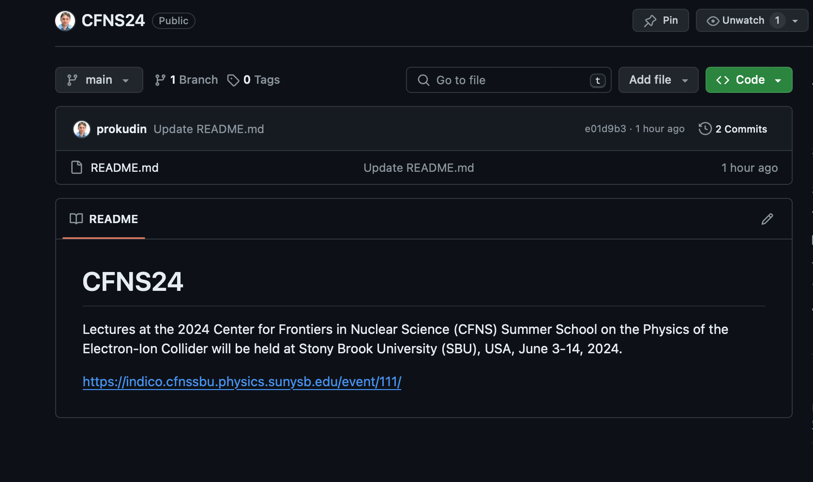
material
https://inspirehep.net/literature/2650019
https://github.com/prokudin/CFNS24
Clone the repository, or download files from github

Slide 4
Transverse momentum dependent distributions

Slide 5
Semi inclusive deep inelastic scattering

Slide 6
Semi inclusive deep inelastic scattering

Slide 7
Semi inclusive deep inelastic scattering

Slide 8
Semi inclusive deep inelastic scattering

Slide 9

the school schedule
The school runs in person 9:00 am - 3:30 pm ET US.
In the evening we have recitations/discussion at 7:30 pm (snacks & drinks are provided)
The program is posted on Indico: https://indico.bnl.gov/event/17958/timetable/#20230605

